Slide 1
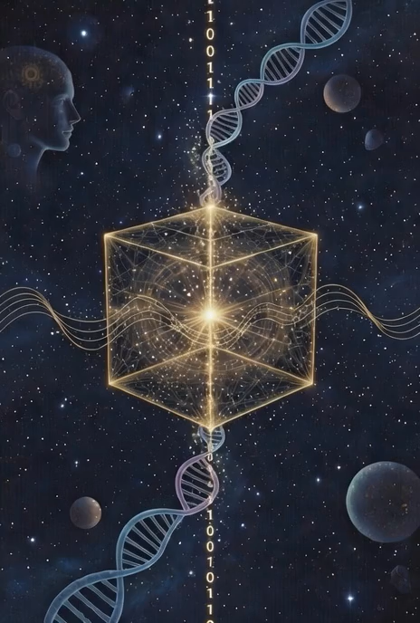




S N I C
Mapping Hidden Connections Between Artists Using Audio Features, Lyrics, Cultural Significance, and Metadata for Industry Professionals….
…..Searching for Hidden Pieces of Your Musical Soul, re-discovering your Sonic Youth, and feeling the Beat of Your Past.
CART GR PHY
Notes:
Open: Genre is a marketing label. Streaming recommendations are based on what other people listen to, not what the music actually is. This project builds a pipeline to cluster music by what it sounds like, what it says, who made it, and how it's valued — then serves that data for analysis. Everyone on the team picks 50 artists. Your favorites, your parents' records, your kids' playlists. Albums are the data points — an artist isn't a dot, it's a path through the feature space.

Slide 2
BUSINESS SITUATION & WHY
The Business Problem
Why Data Engineering
Streaming platforms recommend music based on collaborative filtering — what other listeners liked — not on what the music actually is.
Genre tags are marketing categories assigned by labels, not sonic descriptions. This creates algorithmic echo chambers.
A content-based system that clusters albums by audio fingerprint, lyrical DNA, and cultural weight would serve A&R discovery, playlist curation, and catalog valuation.
Or: a personal app to find your musical lineage and style.
Multi-source integration: audio features, lyrics text, relational metadata, and marketplace transactions are four fundamentally different data types.
Schema normalization: Spotify thinks in tracks, Genius in songs, MusicBrainz in releases, Discogs in pressings. Same album has four identities (and more).
Data quality at scale: ~1,200 albums across 4-7 sources
Serving: the core job is delivering a unified album-level model ready for downstream analysis.
Notes:
Two assignment questions on one slide. Business situation: collaborative filtering vs. content-based analysis. Real applications in A&R, playlist curation, catalog valuation. Why DE: four different data paradigms, entity resolution across sources with different schemas, quality issues at scale, and the core job is serving clean unified vectors for downstream analysis.

Slide 3




DATA SOURCES
Spotify API
Genius API + NLP
Audio features per track: tempo, energy, valence, acousticness, danceability, instrumentalness, loudness, speechiness. Aggregated to album level for sonic center of gravity and within-album variance.
Full lyrics text processed through NLP: tense distribution, vocabulary density, self-reference ratio, repetition structure, sentiment trajectory. Adds a lyrical dimension independent of sound.
MusicBrainz
Discogs/Wash U’s Ethnomusicology Database
Producer credits, session musicians, collaboration networks, geographic origin. Maps the "who made it with whom" graph — shared producers create measurable sonic inheritance. What does the tree look like in different eras? Different cultures?
Genre/style taxonomy and marketplace pricing data. Secondary market value is a proxy for cultural endurance that streaming numbers don't capture. Ethnomusicology database has 3000 hours of localized traditional music spanning 6 continents. What do your musical tastes map back to?
Notes:
Four sources, four data paradigms. Spotify = numeric API. Genius = unstructured text requiring scraping + NLP. MusicBrainz = relational graph data. Discogs = transactional marketplace data. Each source answers a different question about the same album. The engineering challenge is unifying them into a single album-level model.

Slide 4
ANTICIPATED CHALLENGES
Entity Resolution
Same album has different identifiers across all four sources. Requires fuzzy matching on artist + album + year with confidence scoring and manual review for edge cases like reissues, deluxe editions, and regional variants.
Coverage Gaps
Older artists may be missing from Spotify or have incomplete lyrics in Genius. Need graceful degradation — partial data is still useful, but completeness must be tracked and reported per album.
Lyrics Cleaning
Scraped lyrics include annotations, section headers, and contributor notes that must be stripped. Non-English lyrics need separate NLP pipelines or exclusion. Poetic text produces noisier sentiment than prose.
Rate Limiting
~1,200 albums × ~8 tracks = ~10,000 API calls per source. Rate limits mean ingestion runs over hours. Requires retry logic, checkpointing, and incremental loading.
Notes:
Entity resolution is the hardest real engineering problem here. Coverage gaps show understanding of data quality. Lyrics cleaning is a real NLP challenge. Rate limiting shows production awareness. These are what make this a data engineering project.

Slide 5
TEAM APPROACH & DE LIFECYCLE
Team Structure (3–4 people)
Lifecycle Alignment
Wk 1–2
Foundation
1
Generation
Everyone submits 50 artists. Set up repo, build master album list, agree on data contracts.
Data across Spotify, Genius, MusicBrainz, Discogs
2
Ingestion
Wk 3–5
Parallel Pipelines
Parallel API pipelines with rate limiting and checkpointing
Each person owns one source end-to-end: Spotify, Genius+NLP, MusicBrainz, Discogs+entity resolution.
3
Storage
Integration & QA
Raw → staging → serving (three-layer architecture)
Wk 6–7
Unified album model, data quality checks, clustering and visualization, served dataset.
4
Transformation
Entity resolution, NLP extraction, track → album aggregation
Wk 8
Presentation
Polish visualization, document code, prepare demo.
5
Serving
Unified album vectors for clustering and analysis
Notes:
Two assignment questions combined. Team: parallel pipelines with shared data contracts. Everyone contributes artists in week 1 for immediate buy-in. Each person owns a source. If 3 people, combine Discogs + entity resolution. Lifecycle: real engineering at every stage — multiple external systems, different API patterns, three-layer storage, entity resolution + NLP in transformation, analysis-ready vectors in serving.

Slide 6
SERVING THE DATA SCIENCE CONSUMER
The pipeline delivers unified album-level feature vectors. Here's what a data science team can do with them:
Cross-Genre Clustering
Group albums by sonic + lyrical + lineage features rather than genre labels. Find unexpected connections across the dataset — which albums are neighbors when you strip away marketing categories?
Creative Evolution Tracking
Plot an artist's albums as a path through feature space. Compute sonic drift (distance between consecutive albums) and within-album variance to identify when and how an artist's output changed.
Catalog Valuation
Combine audio distinctiveness scores with Discogs marketplace data to identify undervalued catalog assets — sonically unique albums that the market hasn't priced accordingly.
Each group member contributes 50 artists — the dataset is personal from day one. Include your own stuff, include stuff you don’t understand, add your parents top artists, get your grandparents, what did you love when you were kid? What have you returned to….what haven’t you? What do your children like and what else might they like from your era?
Notes:
This is the 'what gets served' slide. The pipeline delivers clean album-level vectors. Three example applications for a data science consumer: clustering across genres, tracking how artists evolve over time, and catalog valuation using marketplace data. Close with: everyone picks 50 artists, albums are the data points, the pipeline serves the analysis. Questions?

Slide 7
What’s in it for you?
The pipeline delivers unified album-level feature vectors. Here's what YOU can do with them:
in addition to the below, I think is something we can all take with us. The dataset itself could be presented and expanded on in dozens of directions and from multiple different perspectives in follow on projects.
Cross-Genre Clustering
What artists are you missing out on? What artists are you likely to like based on what has been important to you in the past? Download your Apple playlist on your own and run it through the engine, what’s in there that you didn’t expect? What do we have in common with each other? What artists are most important to you? Why? When?
Creative Evolution Tracking
Feel like a particular artists speaks to you for years with every album and then one drops that you just “don’t get?” Find out why? Which of your favorites are looking like they are about to break out of a mold? Predictive analytics, (not simple pattern matching) on your musical journey. You tell the recommendation system goodbye forever and start setting your own path.
Musical Geneology
What are the musical roots of who speaks to you? Where should you look into the past to find artists that inspired them or share their characteristics? Is your family history or cultural influential on your choices? Do you gravitate to a music for a reason? What could you learn from that?
Each group member contributes ~50 artists — the dataset is tuned to you from day one.
Notes:
This is the 'what gets served' slide. The pipeline delivers clean album-level vectors. Three example applications for a data science consumer: clustering across genres, tracking how artists evolve over time, and catalog valuation using marketplace data. Close with: everyone picks 50 artists, albums are the data points, the pipeline serves the analysis. Questions?

